Slide 1

predicting-wine-quality-with-several-classification-techniques

Slide 2
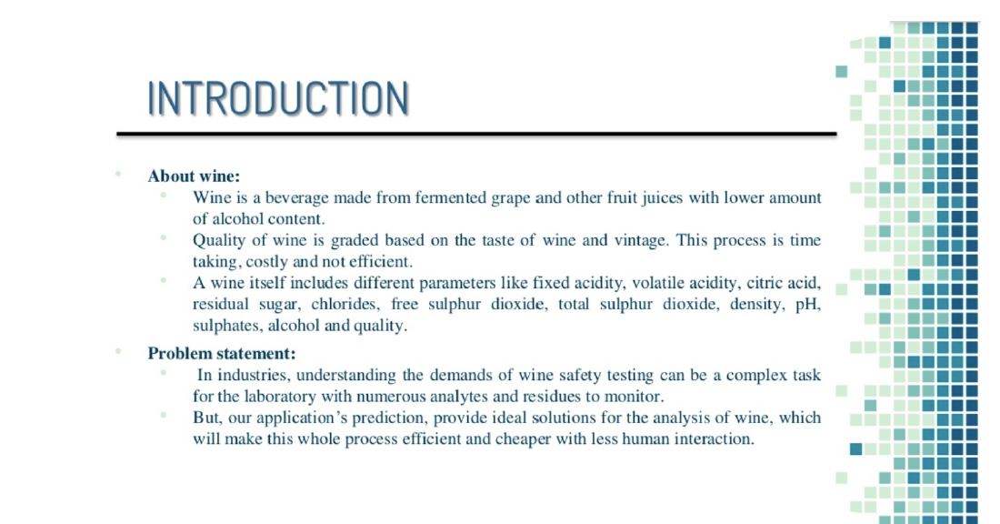

Slide 3
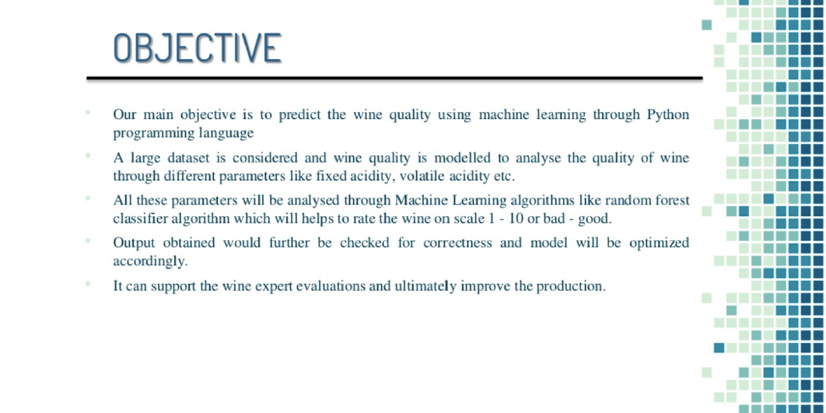

Slide 4
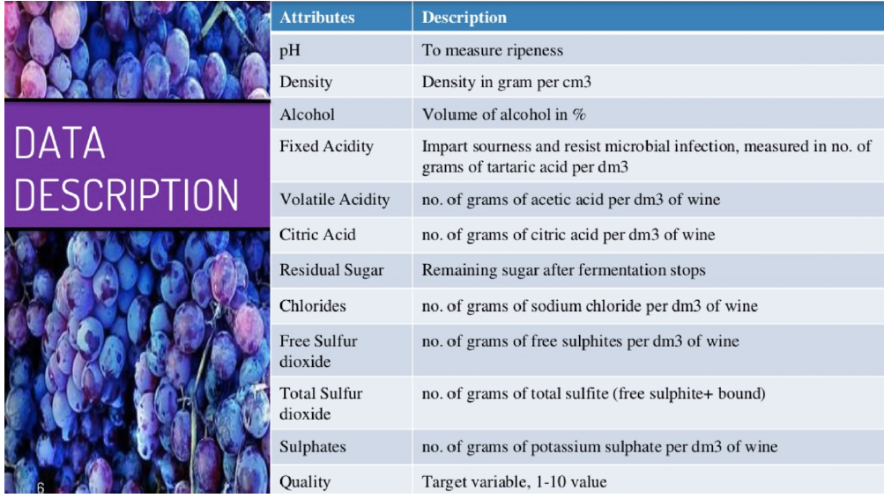

Slide 5
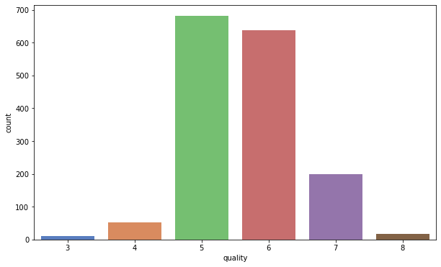
Wine Quality Range

Slide 6
DATA ANALYSIS
The four important features to predict the quality of wine is volatile acidity', 'total sulfur dioxide’, 'sulphates', 'alcohol
As alcohol is one of the most important feature to decide the quality of wine higher the concentration of alcohol leads to better quality and lower density of wine.

Slide 7
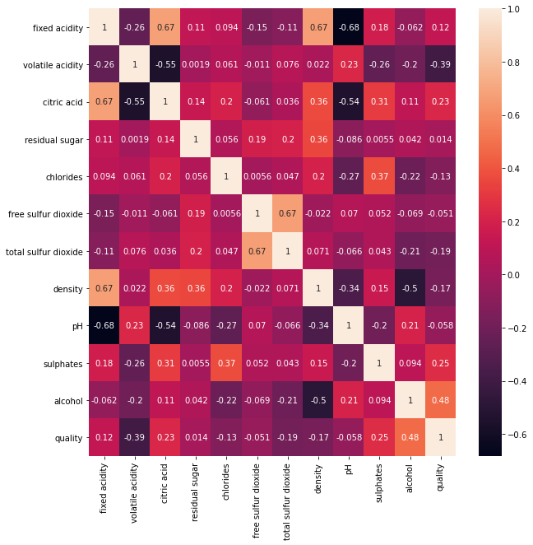
Correlation
density has a strong negative correlation with alcohol.
pH & fixed acidity has negative correlation.
citric acid & volatile acidity has negative correlation.
free sulphur dioxide & total sulphur dioxide has positive correlation.

Slide 8
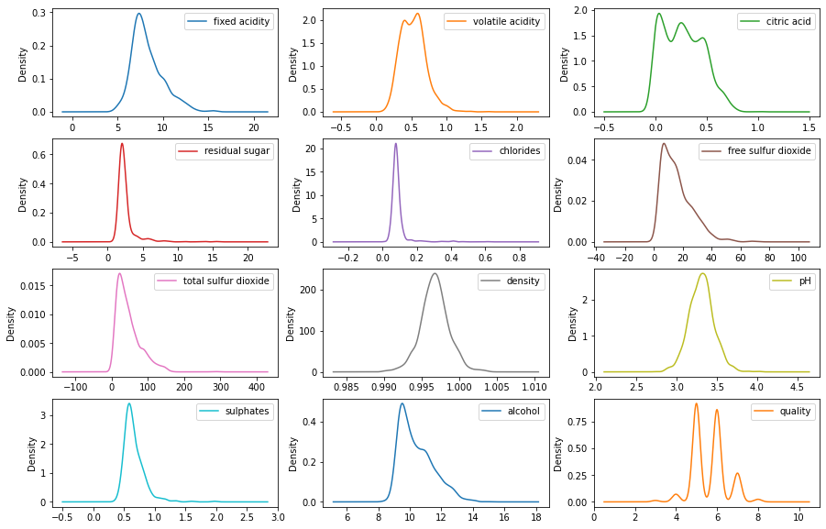
#Density and Sulphates and fixed acidity are Noramally distributed .
#here we can observe that most of the features has skew-ness

Slide 9
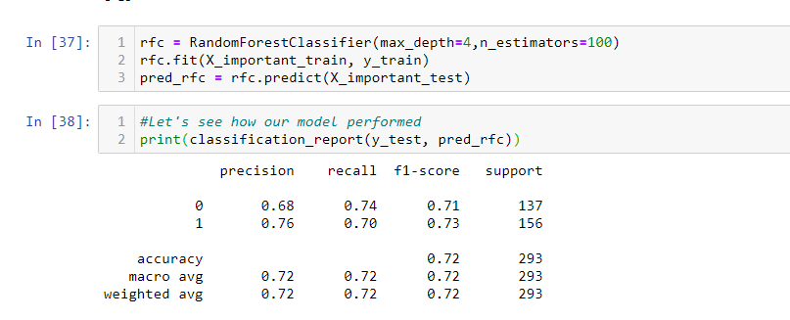
RF On Testing Accuracy

Slide 10
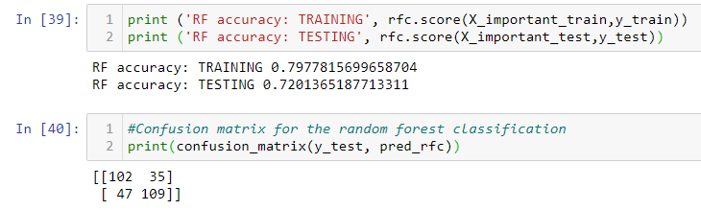
RF Confusion Matrix

Slide 11
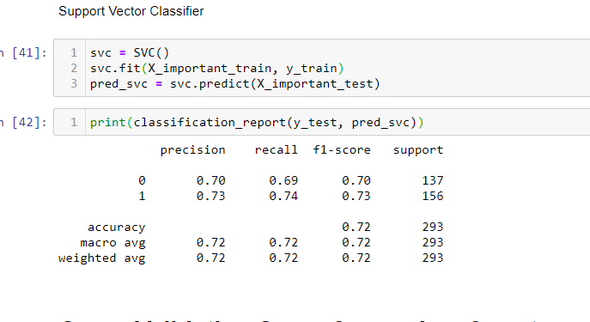
SVM model Accuracy

